Slide 1
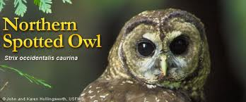
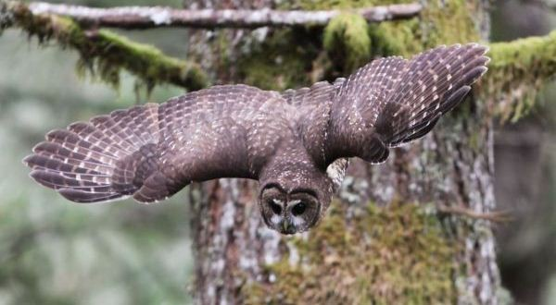

Slide 2
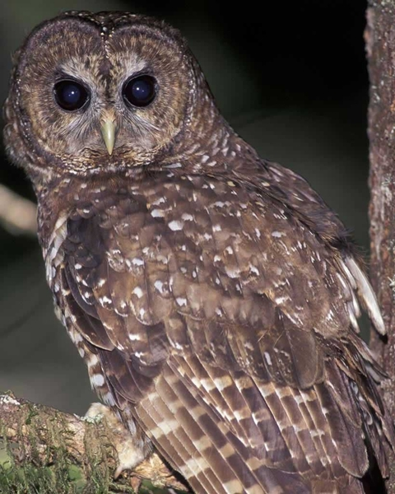
#1 Adult Northern Spotted Owl
An adult can be up to 16 ½ - 19“ (42-48cm). A medium sized owl without ear tuffs.

Slide 3
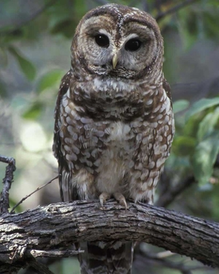
#2 Adult Northern Spotted Owl
The upper parts are usually dark brown with white spots, the under parts white, heavily barred with dark brown eyes.

Slide 4
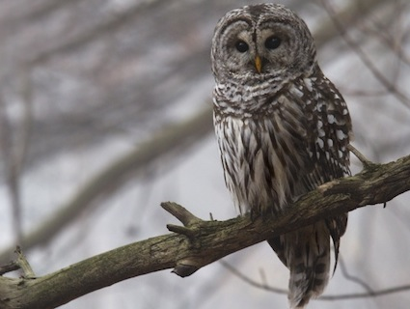
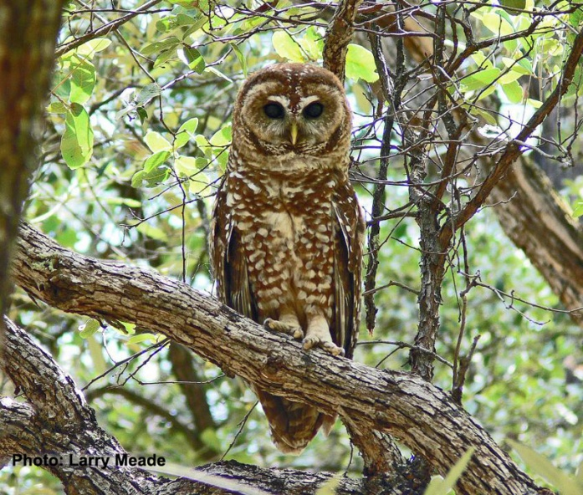
#3 Adult Northern Spotted Owl
The barred owl has bars down his front side.
The Northern spotted Owl has spots down his front side.
This makes them very distinguishable from each other.

Slide 5
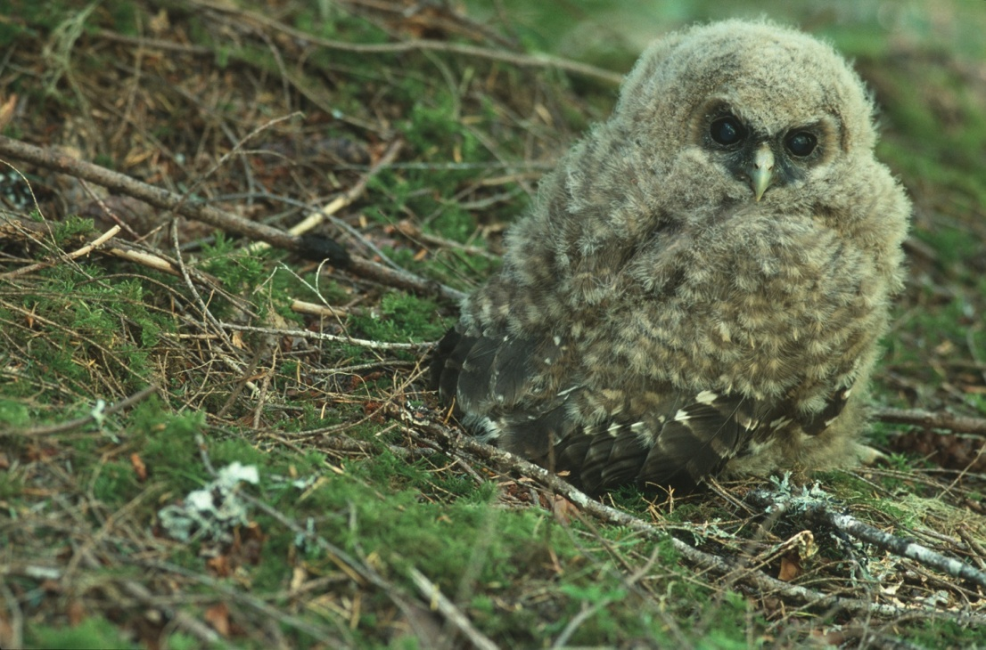
A juvenile spotted owl
The dispersal of juvenile northern spotted owls was studied in western Oregon from 1982-1985. They did this to study their survival and use of environment.

Slide 6
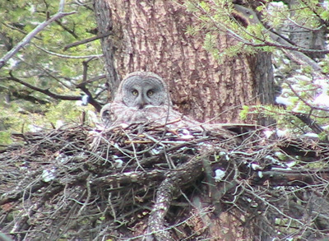
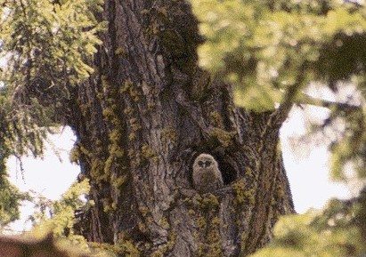
Nesting
The northern spotted owl nests in nest made of twigs and a couple other items found around on the ground. Some of them will nest in a tree to help protect their young from most predators.

Slide 7
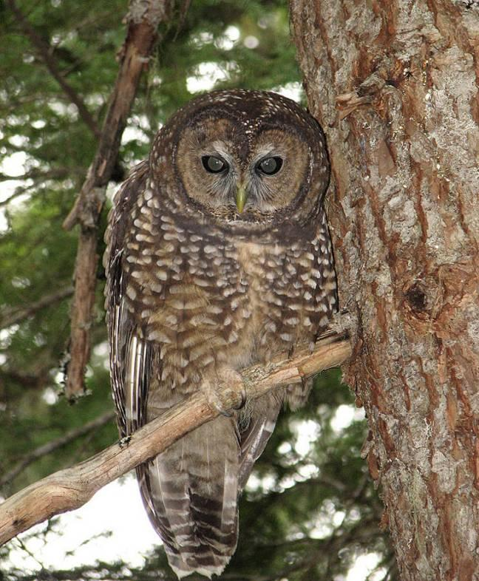
Nesting
Some of the spotted owls will nest/perch on a branch.

Slide 8
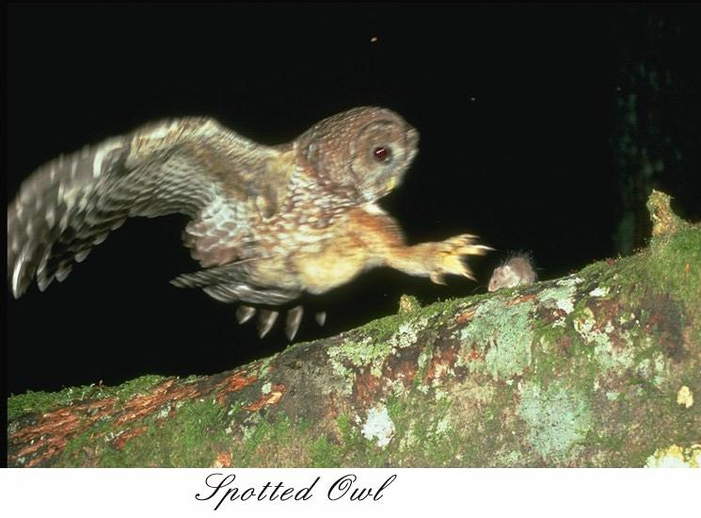
Now for the attack.
Here’s the spotted owl swooping in for the strike to get his/her meal.

Slide 9
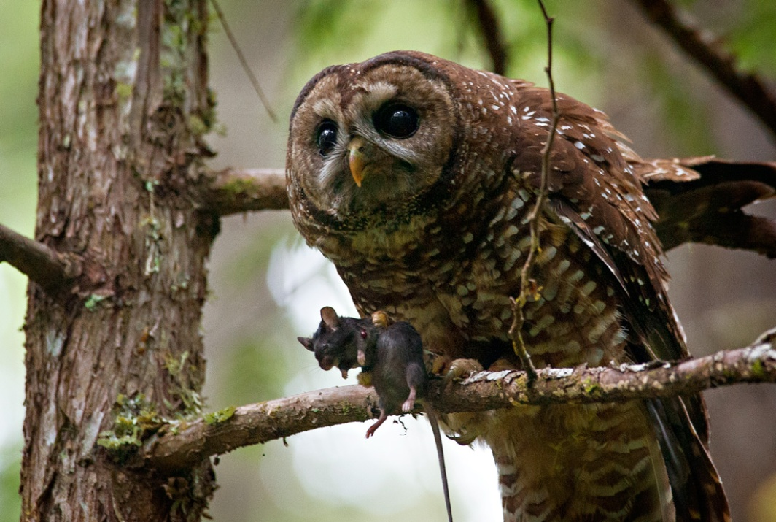
This owl has his/her prey. It looks as if he just landed from grabbing the rodent.

Slide 10
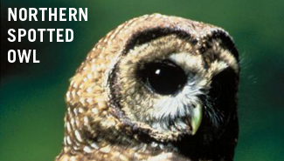
Why we’re on the endangered list.
The northern spotted owl is Federally listed under the Endangered Species Act.
Help Save Our Population

Slide 11
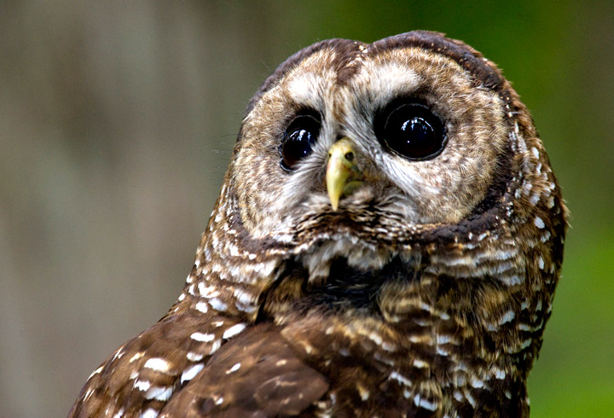
Where they are endangered.
We are being threatened in Washington, Oregon, and California, and state-listed as threatened in Cali and Oregon, and endangered in Washington.

Slide 12
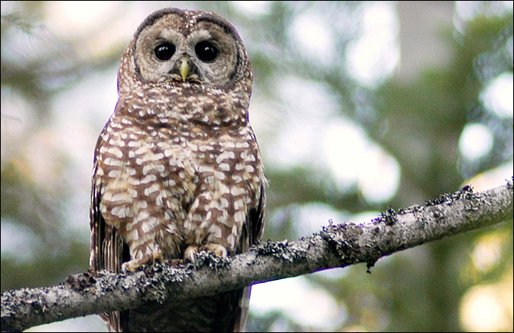
What are we doing to make them endangered?
You are logging all the old growth forests in Washington that we nest and breed in.

Slide 13
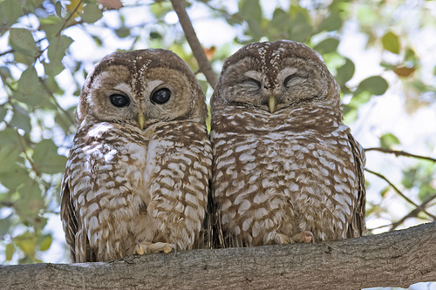
What can we do to help them recover?
You can adopt one of us to help take care of us, you can take action and send a message to your government, and you could become a wildlife defender.

Slide 14
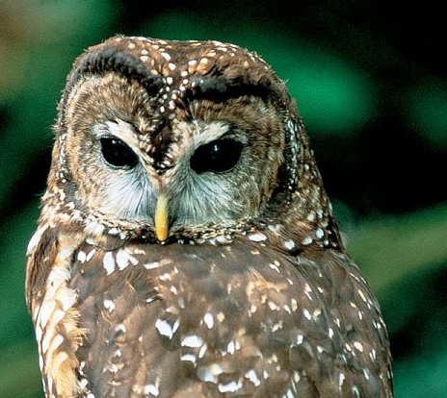
What we are doing to help.
Wildlife officials have announced a plan to send hunters into the woods to kill some of the barred owls to save the northern spotted owl in the Pacific Northwest this fall.

Slide 15
Fun facts
They live in old evergreen forests
The Spotted Owl eats small mammals like flying squirrels, wood rats, mice, voles and also some birds, reptiles, amphibians, and insects.
Spotted owls are mostly nocturnal but they may also forage for food during the day.

