Slide 1
California Least Tern
(Sterna antillarum browni)
By: Robin Heiartz-Martin

Slide 2
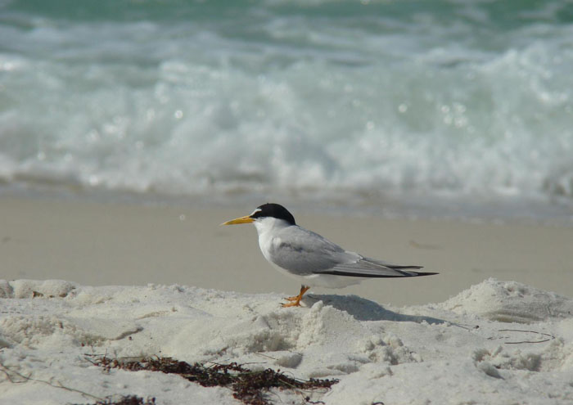
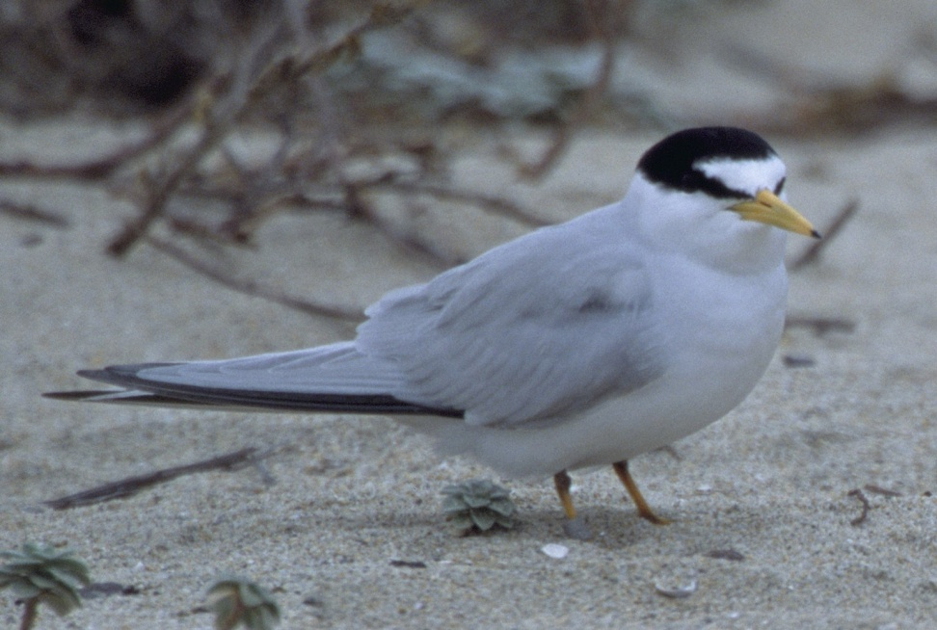
Adult
Long, narrow wings and a broad, forked tail identify the California least tern.

Slide 3
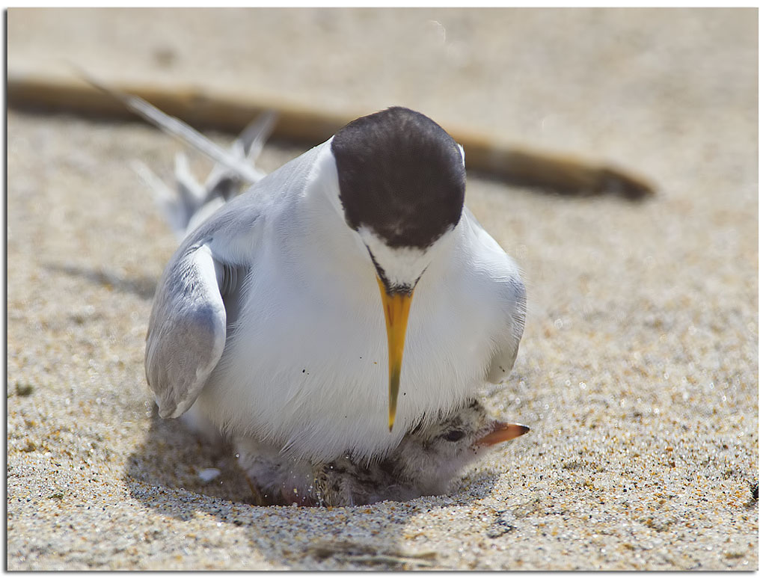
They also have a black-capped head and black-tipped, pale gray wings of the least tern contrast with its white body. It bears a white blaze across its forehead, dark forewings, black-tipped yellow bill, and yellowish feet.

Slide 4
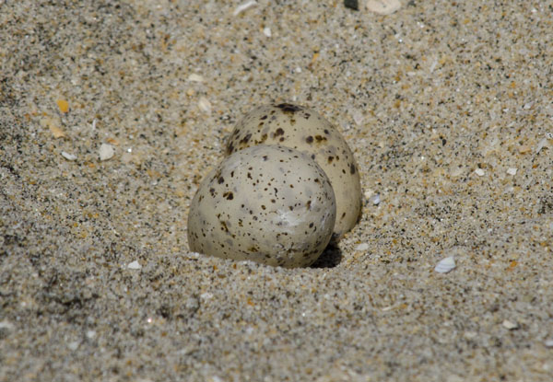
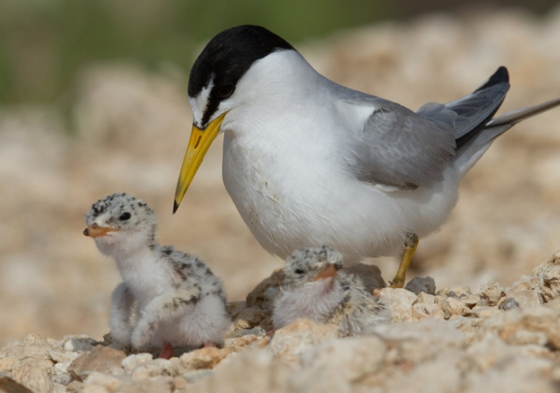
Juvenile

Slide 5
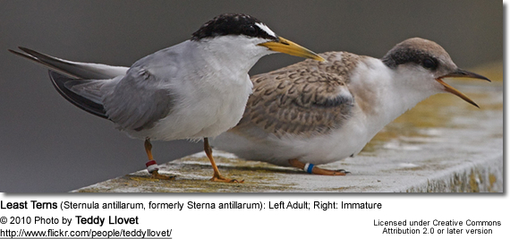
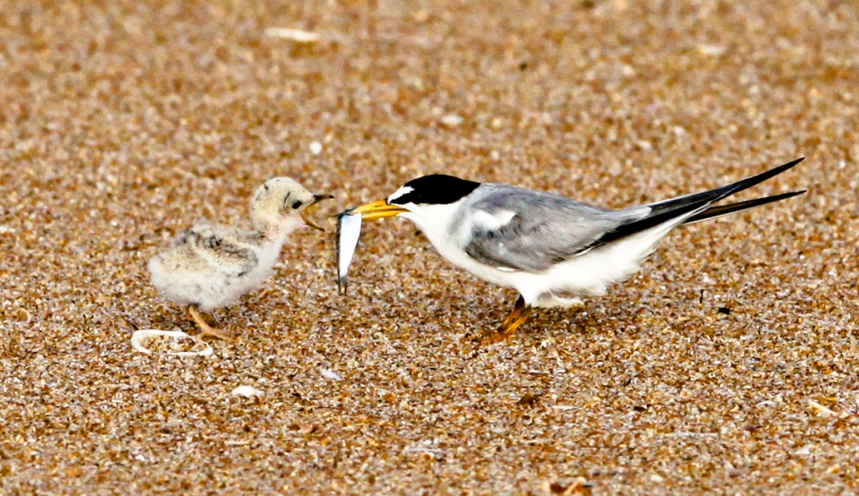
In this picture:
The left one is the adult
The Right one is an immature

Slide 6
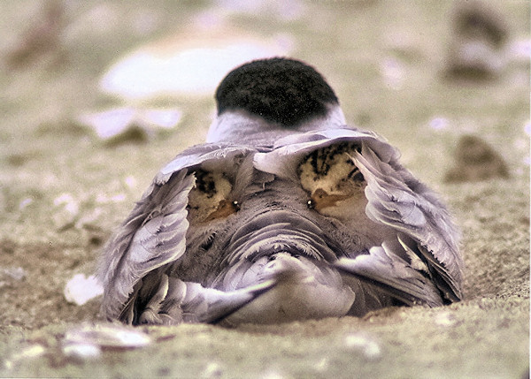
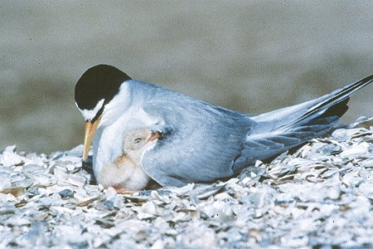
Nesting

Slide 7

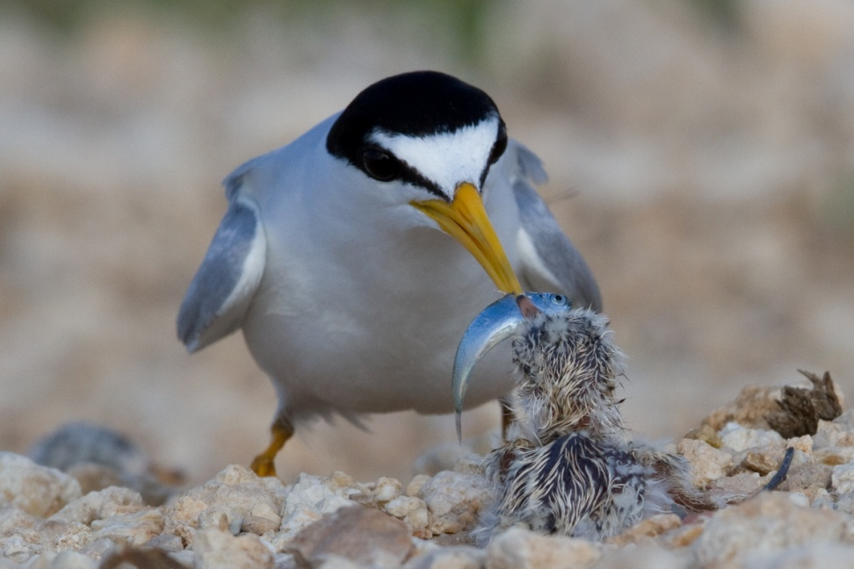
Feeding

Slide 8
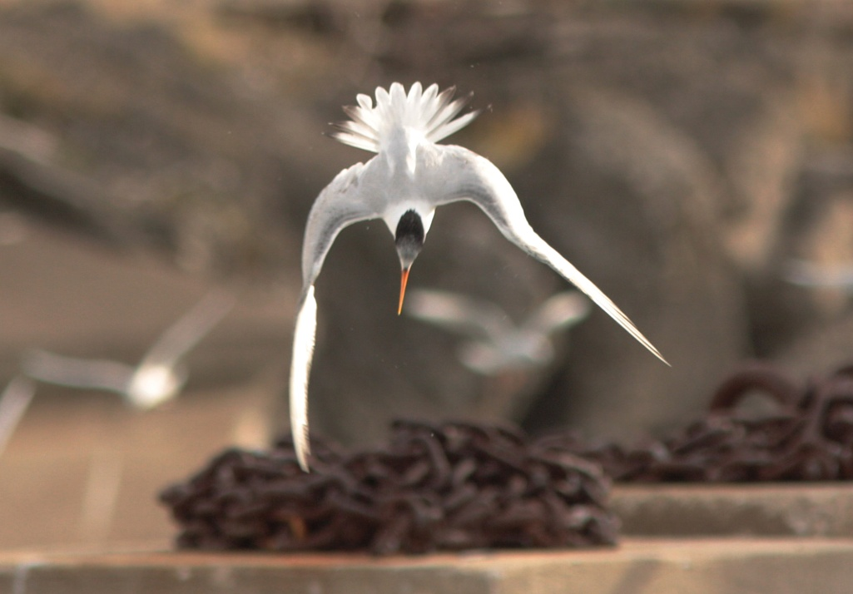
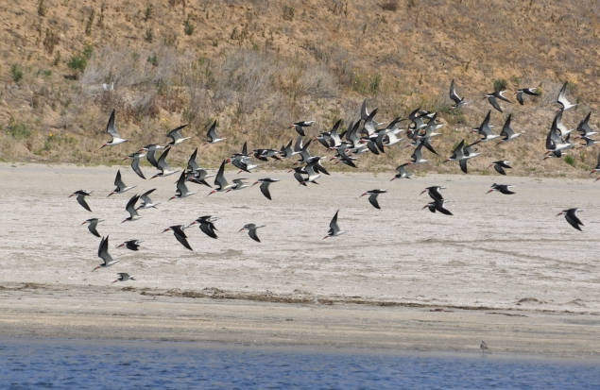
Foraging
happens along shallow waters
marine coasts, feeds primarily in bays, lagoons, estuaries, river and creek mouths, tidal marshes, and lakes

Slide 9
Man Threats
Dredging
Habitat loss due to Urban Development
Nesting disturbances
Pollution
The construction of the Pacific Coast Highway
Domestic dogs and cats
The species is endangered because their natural habitats are becoming very vulnerable due to many factors.

Slide 10
Natural Threats
Larger birds
Mammals such as raccoons and foxes
Other causes to their species.

Slide 11
What we can do to help
Ideas
Keeping dogs and cats indoors.
When you go to the beach, pay attention to signs warning you that birds are nesting.

Slide 12
Programs
California Least Tern Endangered Species Protection Program -San Diego International Airport
Habitat management today focuses on protection of nesting sites from predators and human disturbances. Various nesting sites along the coast are monitored primarily by volunteers.
SDAS is working in Mission Bay and San Diego Bay to restore Least Tern nesting habitat.
We currently have active projects at the D-Street Fill in the Sweetwater Marsh National Wildlife Refuge and at Mariner’s Point in Mission Bay.

Slide 13
Other Facts
CA Least Terns live along the coast.
They nest on open beaches kept free of vegetation by the tide. The typical colony size is 25 pair.
They eat mostly small fish.
The least tern is the smallest of North American terns. It is 21-23 cm (around 8¼ to 9 inches) long. Its wingspan is 48-53 cm (around 19 to 21 inches).
The nest is a simple scrape in the sand or shell fragments.
Typically there are 2 eggs. Both parents incubate and care for the young. They can re-nest up to two times if eggs or chicks are lost early in the breeding season.

Slide 14
Males and Females look similar
Least Terns defend their nesting colony against a predator by flying up, calling loudly, and pooping on their target
A group of least terns are collectively known as a "straightness" of terns.
Least terns are the smallest member of the gull and tern family.
This bird is native to South America, the Caribbean, North America and Central America.

