Slide 1
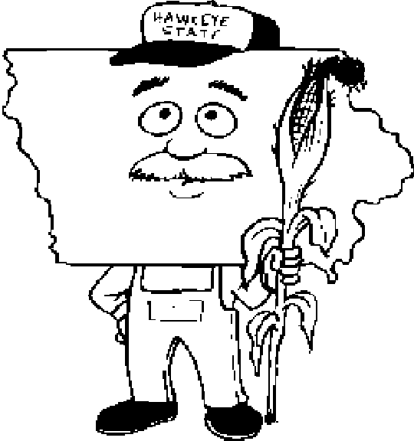
Texas and Iowa
Janee Swaney and Hannah Johnson

Slide 2
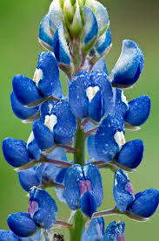
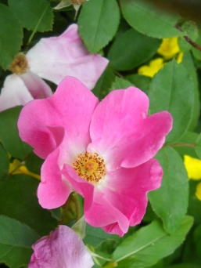
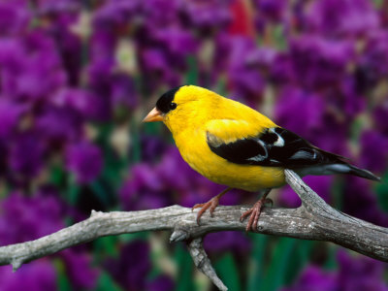
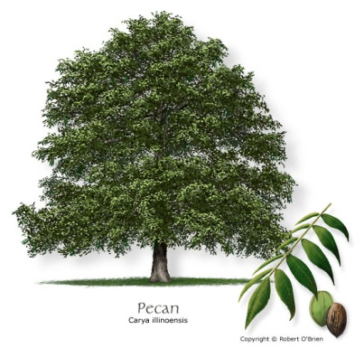
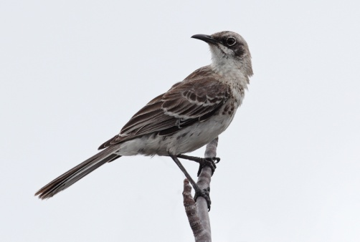
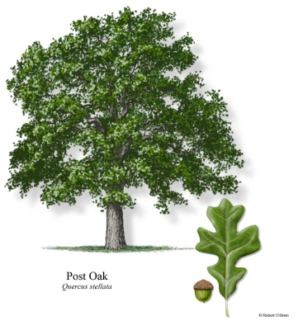
State Info
29th state formed, Dec. 28, 1846
Capital: Des Moines
State Bird: Eastern Goldfinch
State Tree: Oak
State Flower: Wild Rose
AKA: The Hawkeye State
28th state formed, Dec. 29, 1845
Capital: Austin
State Bird: Mockingbird
State Tree: Pecan
State Flower: Blue Bonnet
AKA “Lone Star State”
Texas
Iowa

Slide 3
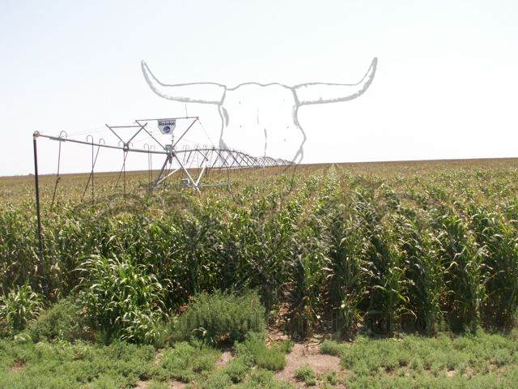
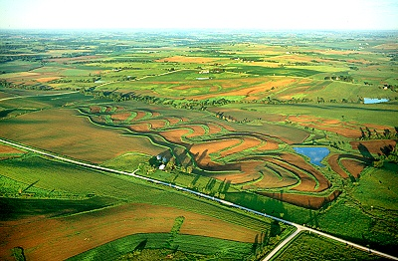
State Info
247,500 Farms
527 acres is average farm size
130 million acres in farmland
92,600 Farms
331 acres is the average farm size
30.7 million acres of farmland
Texas
Iowa

Slide 4
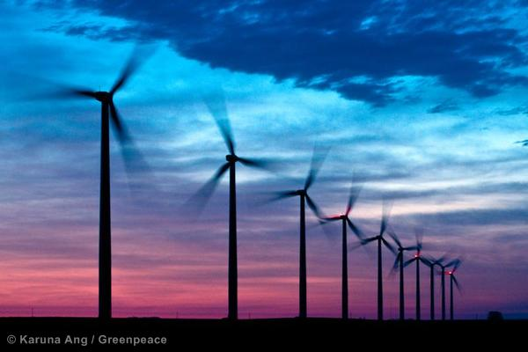
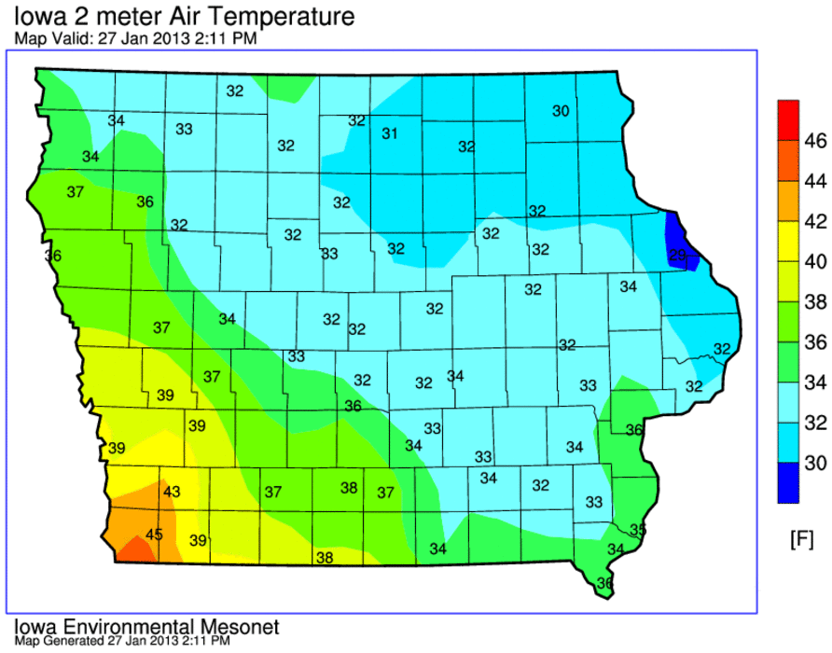
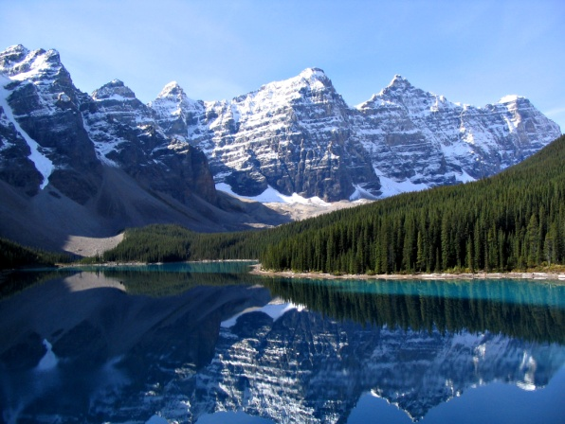
Climate and Soil
Iowa is the 10th windiest state in the nation.
Annual average temperature is 49°
Hot humid summers
4 diverse regions varying from mountains (Rocky Mts.) and ocean (Gulf of Mexico
Texas
Iowa

Slide 5
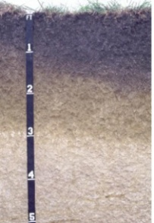
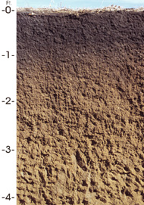
Climate and Soil
11,000 different soils
Some of the richest and most productive soil.
State soil: Tama
1,100 different soils
State Soil: Houston Black Clay
Texas
Iowa

Slide 6
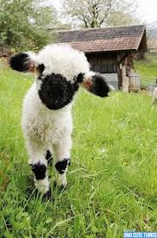
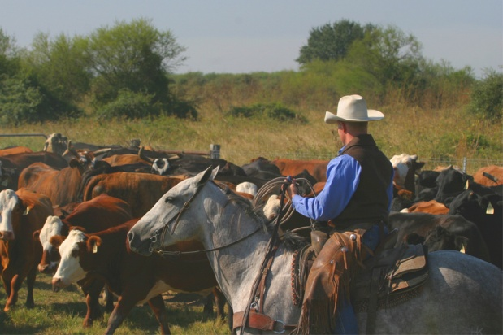
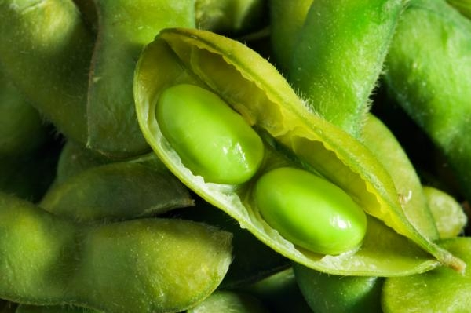
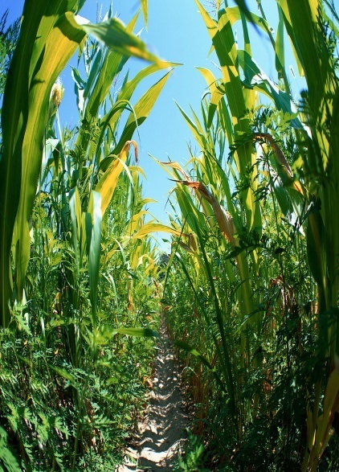
Crop and livestock
# 1 in nation: cattle, cotton, sheep/goats, wool, hay
Ranks number 1 in corn and soybean production.
Texas
Iowa

Slide 7
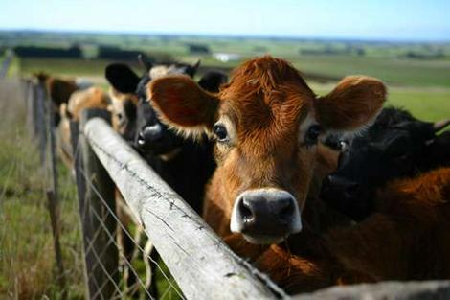
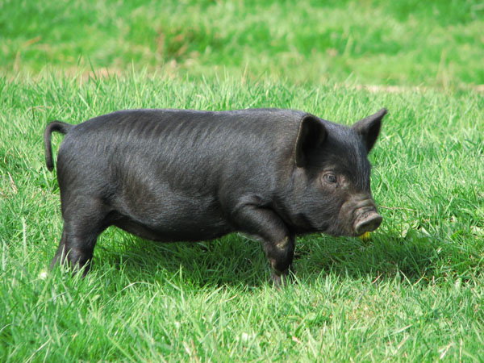
Crop and livestock
Leading state in cattle production
Leads the nation in hog and egg production
Texas
Iowa

Slide 8
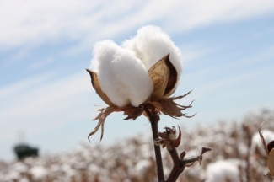
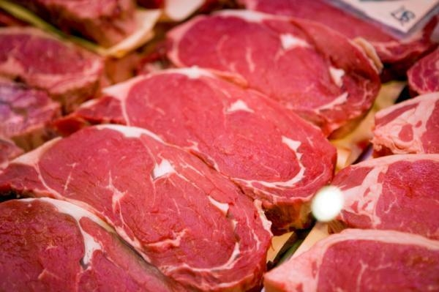
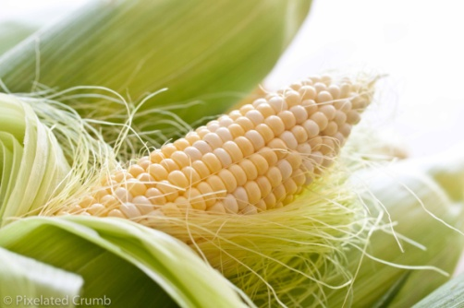
Crop and livestock
Top 5 commodities: cotton, nursery plants, corn, wheat, hay
Iowa ranks 2nd nationally in red meat production.
Texas
Iowa

Slide 9
Energy and usage production
Produces 13 trillion Btu
Uses 80 million Btu
Uses 14% less than the U.S.’s average energy consumption
Produces 700 trillion Btu
Uses 1,500 trillion Btu
Ranked 5th in total energy per Capita consumed
Texas
Iowa

Slide 10
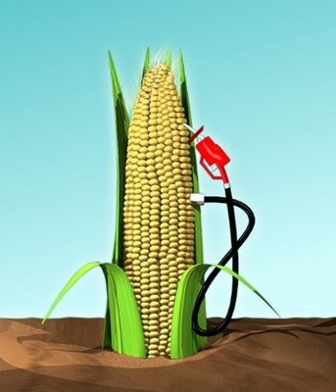
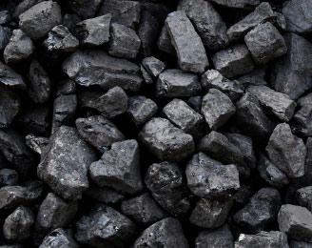
Minerals and mining
Best known for coal extraction
$6.2 billion impact, $2 billion labor income, 23,000 employment opportunities,
$641 billion towards taxes
Best known for ethanol
The largest producer of ethanol in the US in 2011
Texas
Iowa

Slide 11
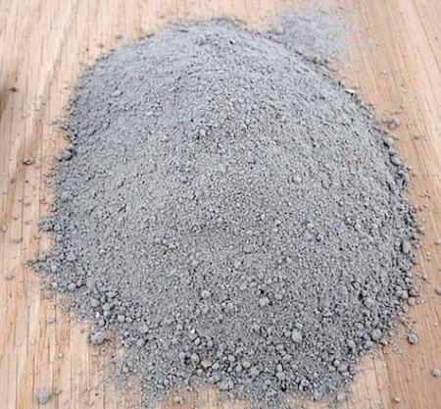
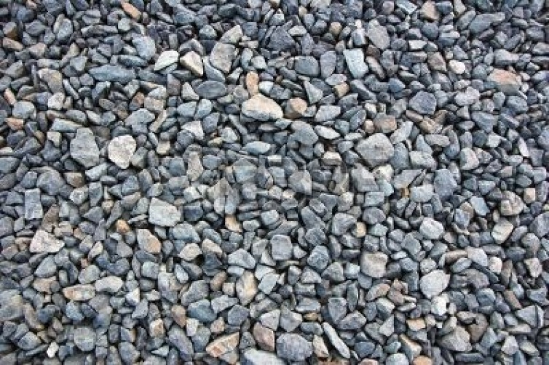
Minerals and mining
Most Financially Valuable:
Portland Cement
Quantity: 8,053
Value: $815,000
Most Financially Valuable:
Crushed Stone
Quantity: 32,600
Value: $297,000
Texas
Iowa

Slide 12
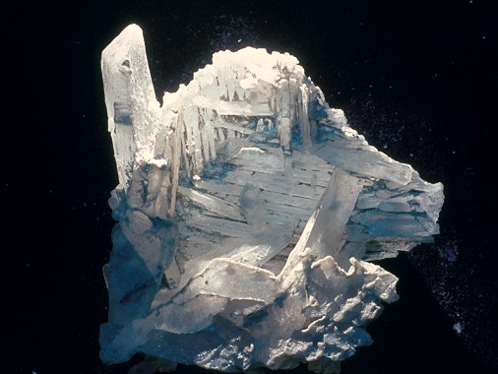
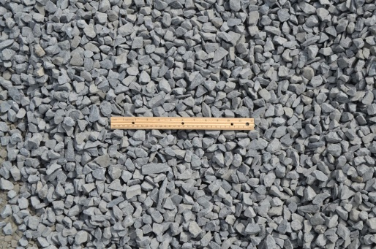
Minerals and mining
Most abundant:
Crushed Stone
Quantity: 110,000
Value: $782,000
In 2001 Iowa ranked 2nd in production of crude gypsum
Texas
Iowa

Slide 13
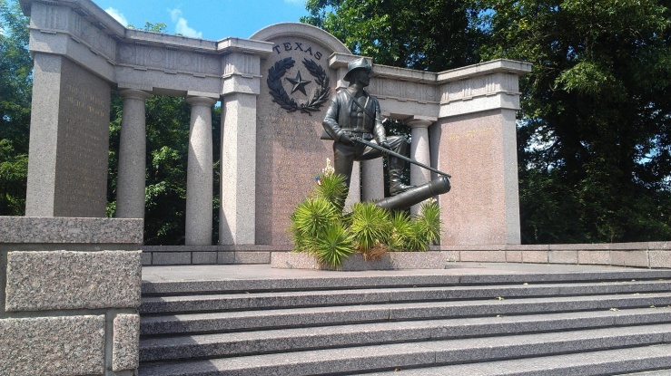
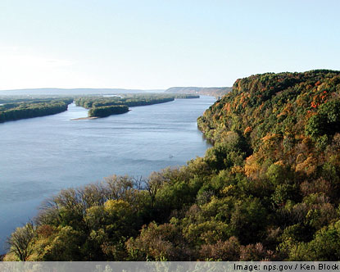
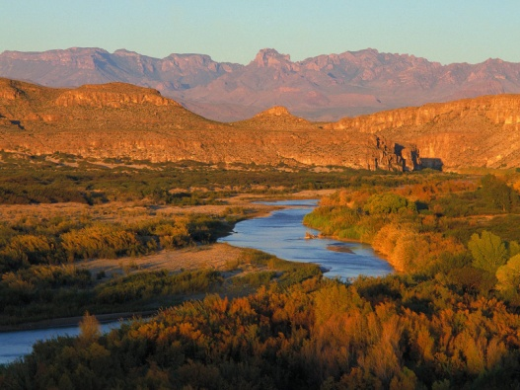
Timber and other resources
Vicksburg
Rio Grande
1 national monument
Effigy Mounds National Monument
Texas
Iowa

Slide 14
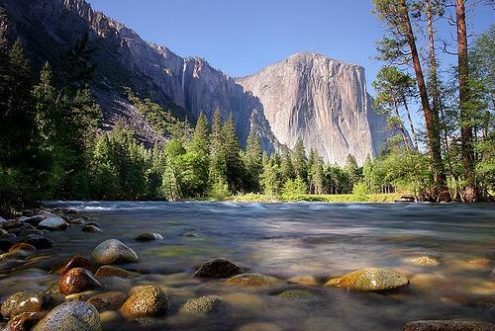
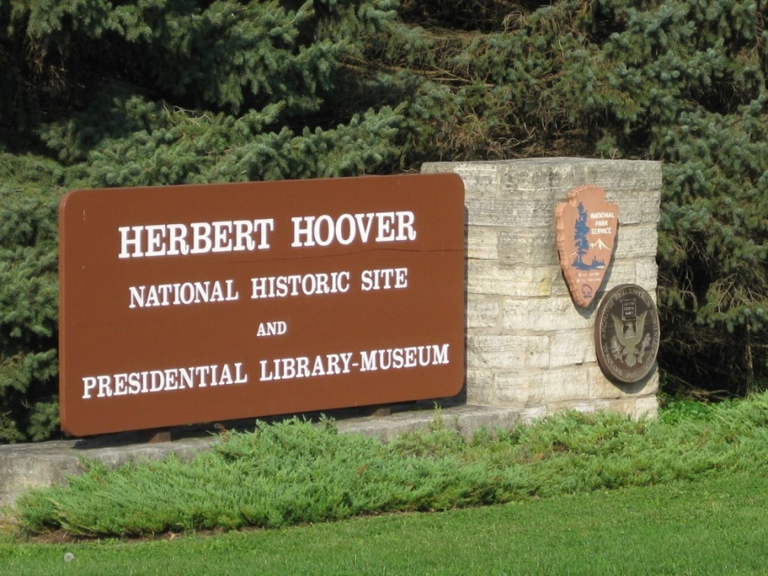
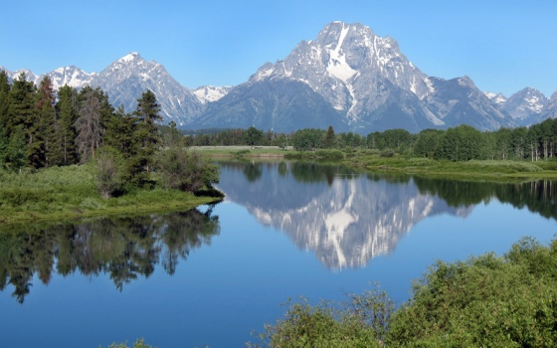
Timber and other resources
Grand Trent
1 historic site
Herbert Hoover National Historic Site
Texas
Iowa

Slide 15
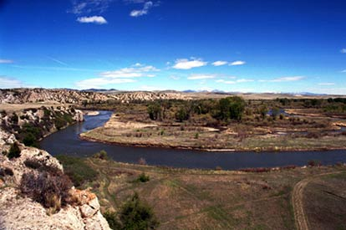
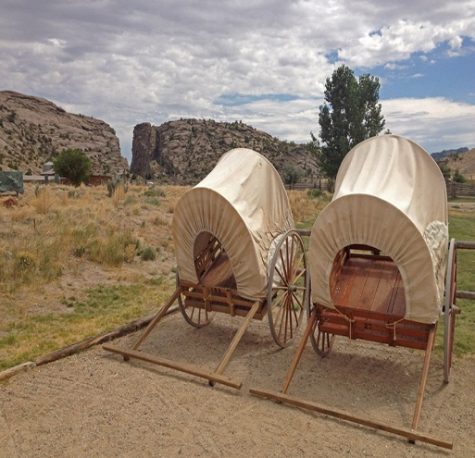
Timber and other resources
4 national recreational locations
2 historic trails
Lewis and Clark National Historic Trail
Mormon Pioneer Historic Trail
Texas
Iowa

Slide 16
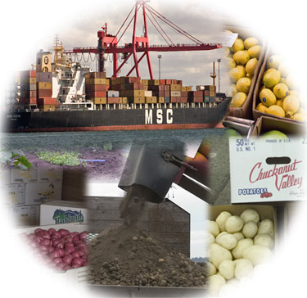
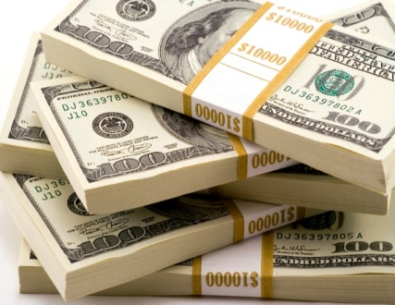
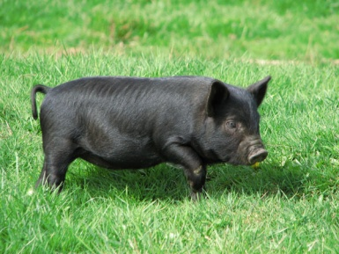
Misc
2nd largest industrial state
$80 billion annual economy
Hogs are a pest that hurts other animals and destroys property.
Ranks 2nd in total agriculture exports
Texas
Iowa

Slide 17
Work cited
"A Look at Texas Agriculture." Ag Classroom. Ag Classroom, July 2010. Web. 4 Feb. 2014.
"A Look at Iowa Agriculture." Ag Classroom. Ag Classroom, July 2010. Web. 4 Feb. 2014.
"U.S. Energy Information Administration - EIA – Independent Statistics and Analysis." eia.gov. U.S. Energy Information Administration (EIA), July 2012. Web. 04 Feb. 2014.
U.S. Energy Information Administration - EIA - Independent Statistics and Analysis." eia.gov. U.S. Energy Information Administration (EIA), July 2012. Web. 04 Feb. 2014.
Baker, Micheal. "U.S. Energy Information Administration - EIA - Independent Statistics and Analysis." Usgs.gov. Texas State Mineral Information, 2009. Web. 04 Feb. 2014.
Baker, Miceal. "IowaState Minerals Information." Usgs.gov. USGS Minerals Information: Iowa, 2009. Web. 04 Feb. 2014.

